Slide 1
performing multivariate analyses using Adegenet 2.00
Peer led Bioinformatics series – Fall 2016
Caroline Judy
https://cran.r-project.org/web/packages/adegenet/adegenet.pdf

Slide 2
Adegenet installation
go here for a short script:
https://github.com/SmithsonianWorkshops/Peer-Led-Bioinformatics/blob/master/Fall2016/Judy-Week5/Install_Adegenet.R
– installation – Adegenet overview – tutorial 1– multivariate analysis – tutorial 2 – real example –

Slide 3
what is Adegenet?
a toolset for exploring genetic and genomic data
originally an extention of ade4
– installation – Adegenet overview – tutorial 1– multivariate analysis – tutorial 2 – real example –

Slide 4
what can Adegenet do?
multivariate methods
graphics
statistical tests
simulation tools
distance similarity measures
spatial methods
– installation – Adegenet overview – tutorial 1– multivariate analysis – tutorial 2 – real example –

Slide 5
what can Adegenet do?
multivariate methods
graphics
statistical tests
simulation tools
distance similarity measures
spatial methods
– installation – Adegenet overview – tutorial 1– multivariate analysis – tutorial 2 – real example –
Notes:
Today we will focus on multivariate methods.

Slide 6
data types
codominant markers
dominant markers
any ploidy
SNPs and sequence data (even whole genomes)
– installation – Adegenet overview – tutorial 1– multivariate analysis – tutorial 2 – real example –

Slide 7
object classes
genind objects (individuals)
genpop objects (populations)
genlight objects (whole genome datasets)
– installation – Adegenet overview – tutorial 1– multivariate analysis – tutorial 2 – real example –

Slide 8
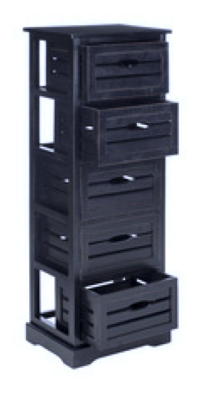
genind objects
formal S4 object with several slots
slots are like drawers
accessed with ‘@’ or $
similar to components of a list
keeps things neat!
– installation – Adegenet overview – tutorial 1– multivariate analysis – tutorial 2 – real example –

Slide 9
slots@
@tab – matrix with dimensions n (individuals) and p (alleles)
@loc.n.all – number of alleles per locus
@type – type of molecular markers (e.g. dom, co-dom)
and many more ... https://cran.r-project.org/web/packages/adegenet/adegenet.pdf
– installation – Adegenet overview – tutorial 1– multivariate analysis – tutorial 2 – real example –

Slide 10
accessors()
nInd()
nLoc()
nPop()
and many more ... https://cran.r-project.org/web/packages/adegenet/adegenet.pdf
– installation – Adegenet overview – tutorial 1– multivariate analysis – tutorial 2 – real example –

Slide 11
data manipulation
use normal subset functions (e.g. your.genind[1:5, 1:5])
convert easily between genind and genpop objects
– installation – Adegenet overview – tutorial 1– multivariate analysis – tutorial 2 – real example –

Slide 12
summary()
tons of useful information:
no. ind
group sizes
no. alleles per locus
no. alleles per group
percent missing data
obs het
exp het
– installation – Adegenet overview – tutorial 1– multivariate analysis – tutorial 2 – real example –

Slide 13
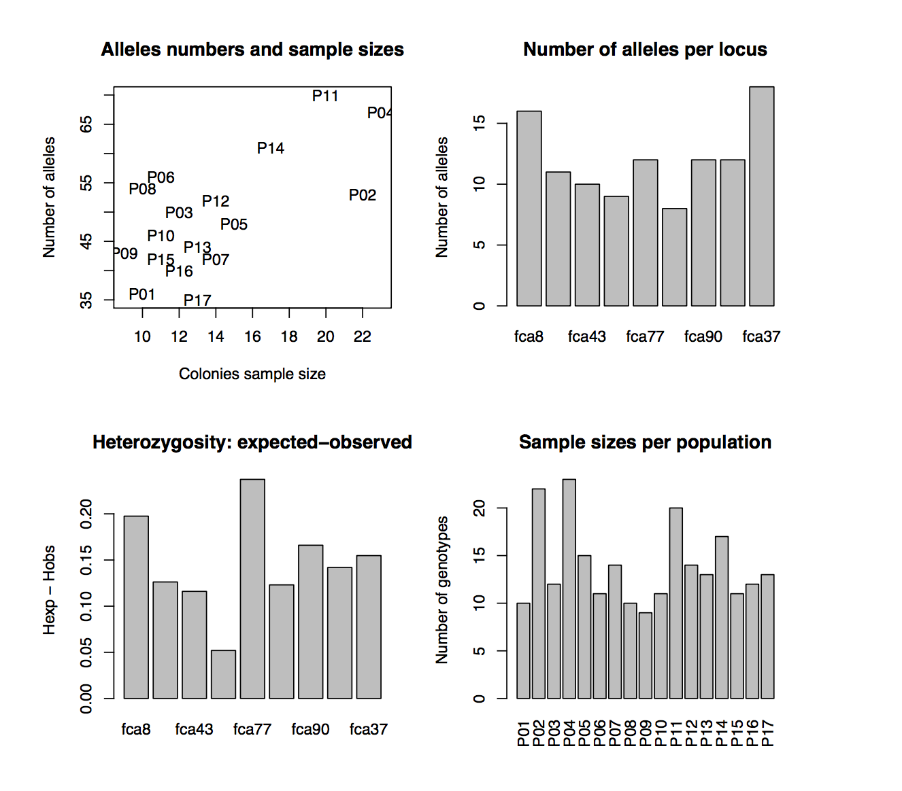
summarizing data
test for HWE
test for structure using F – statistics
measure inbreeding
– installation – Adegenet overview – tutorial 1– multivariate analysis – tutorial 2 – real example –

Slide 14
tutorial 1
1. Call “nancycats.” Is it is a genind object?
2. What type of genetic data is it? Use $ or @ to open the appropriate slot.
3. How many individuals? Use the appropriate accessor.
4. What is the percentage of missing data? Use the summary() command.
5. Make a barplot of the alleles per locus. Hint: try using an accessor to make this easy.
– installation – Adegenet overview – tutorial 1– multivariate analysis – tutorial 2 – real example –

Slide 15
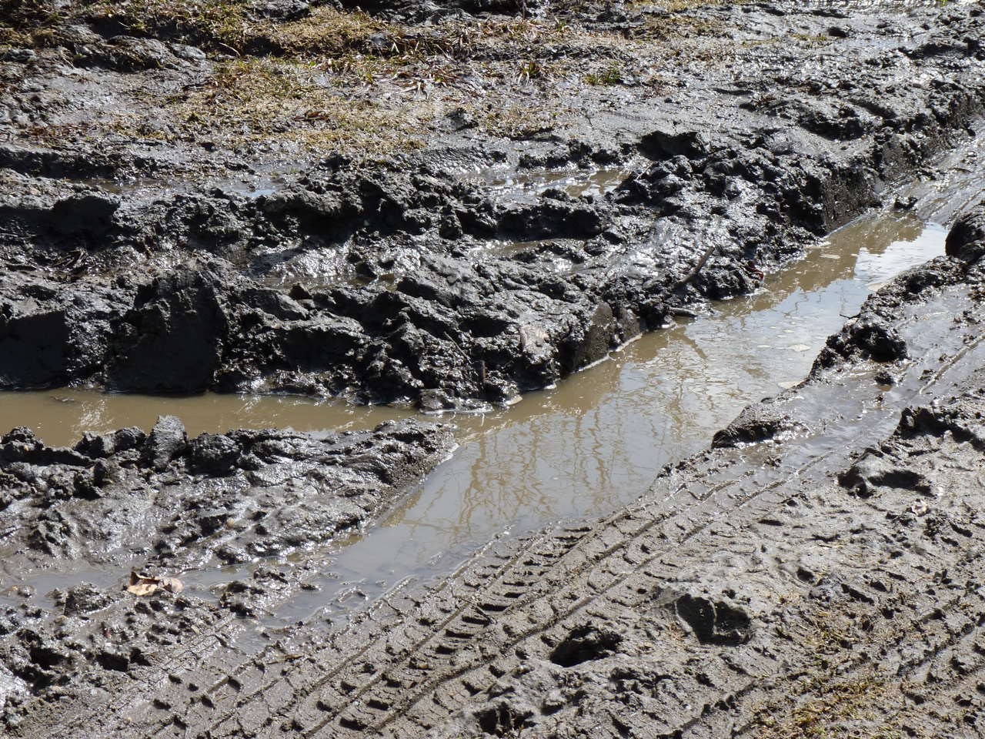
multivariate analysis
confused about terminology?
T. Jombart, D. Pontier, and A-B Dufour. 2009. Genetic markers in the playground of multivariate analysis. Heredity 102:330-341
– installation – Adegenet overview – tutorial 1– multivariate analysis – tutorial 2 – real example –
Notes:
Inertia, eigenvalues, loadings, scores...read “Genetic markers in the playground of multivariate analysis. It’ll make things as clear as mud.

Slide 16
multivariate analyses
PCA – to infer population genetic structuring
sPCA – to infer spatial genetic patterns
DAPC – to infer population structuring among a priori groups, assignment of individuals to pops
A-score – is my structure a biological structure – that is, real?
XVAL – replaces A-score (authors say to use this one)
– installation – Adegenet overview – tutorial 1– multivariate analysis – tutorial 2 – real example –

Slide 17
multivariate analysis
there are a bunch of relevant functions:
scaleGen()
dudi.pca()
sPCA()
dapc()
dist.genpop()
pairwise.fst()
and many more.....
– installation – Adegenet overview – tutorial 1– multivariate analysis – tutorial 2 – real example –

Slide 18
performing PCA on genind objects
1. replace NAs
mean allele freq
zero
leave as is.
2. center and (if necessary) scale your data
usually center on zero
no other scaling is typically necessary since allelic frequencies are comparable.
3. Perform that PCA!
– installation – Adegenet overview – tutorial 1– multivariate analysis – tutorial 2 – real example –

Slide 19
performing PCA on genind objects
scaleGen {adegenet}
replace NAs, center and scale
dudi.pca {ade4}
also performs scaling and centering
performs PCA, outputed as an object:
@eig
@li
@c1
– installation – Adegenet overview – tutorial 1– multivariate analysis – tutorial 2 – real example –
Notes:
$eig: the eigenvalues of the analysis, indicating the amount of variance represented by each principal component (PC).
$li: the principal components of the analysis; these are the synthetic variables summarizing the genetic diversity, usually visualized using scatterplots.
$c1: the allele loadings, used to compute linear combinations forming the PCs; squared, they represent the contribution to each PCs.

Slide 20
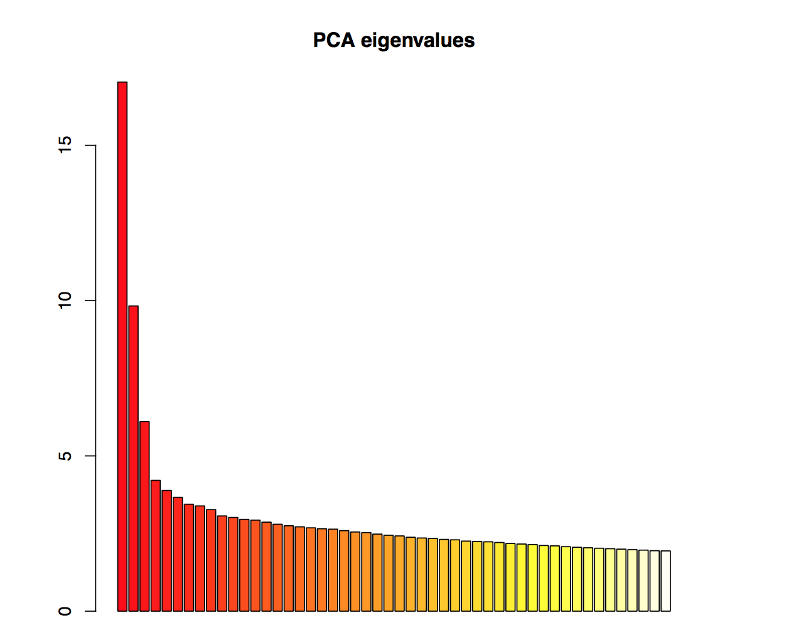
performing pca on genind objects
>dudi.pca(x, cent=FALSE, scale=FALSE)
>select the number of axes to retain
>3
– installation – Adegenet overview – tutorial 1– multivariate analysis – tutorial 2 – real example –
Notes:
So the first step is to select the number of axes to retain. this is an analytical decision. Look for the “elbow”.

Slide 21
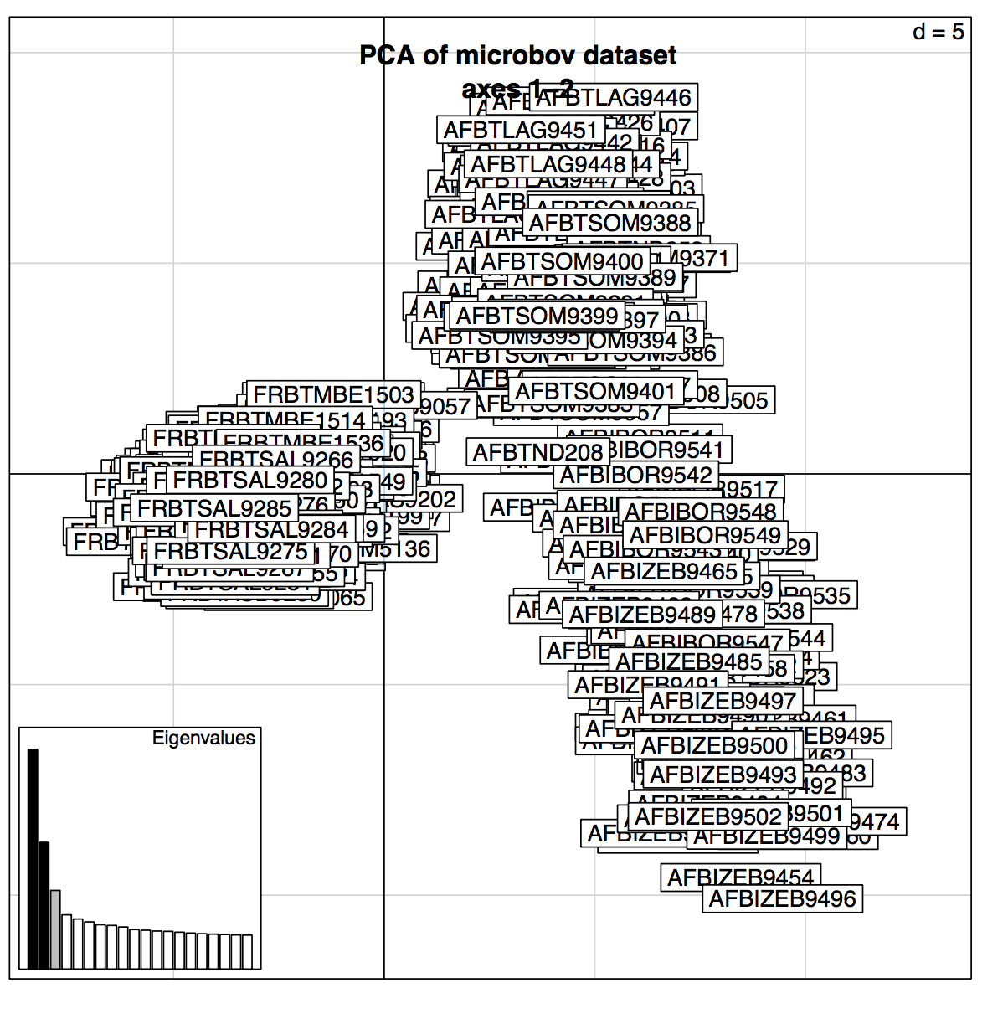
example PCA on microbov dataset
title
→
this is what pca1@li looks like, raw:
scree plot →
– installation – Adegenet overview – tutorial 1– multivariate analysis – tutorial 2 – real example –

Slide 22
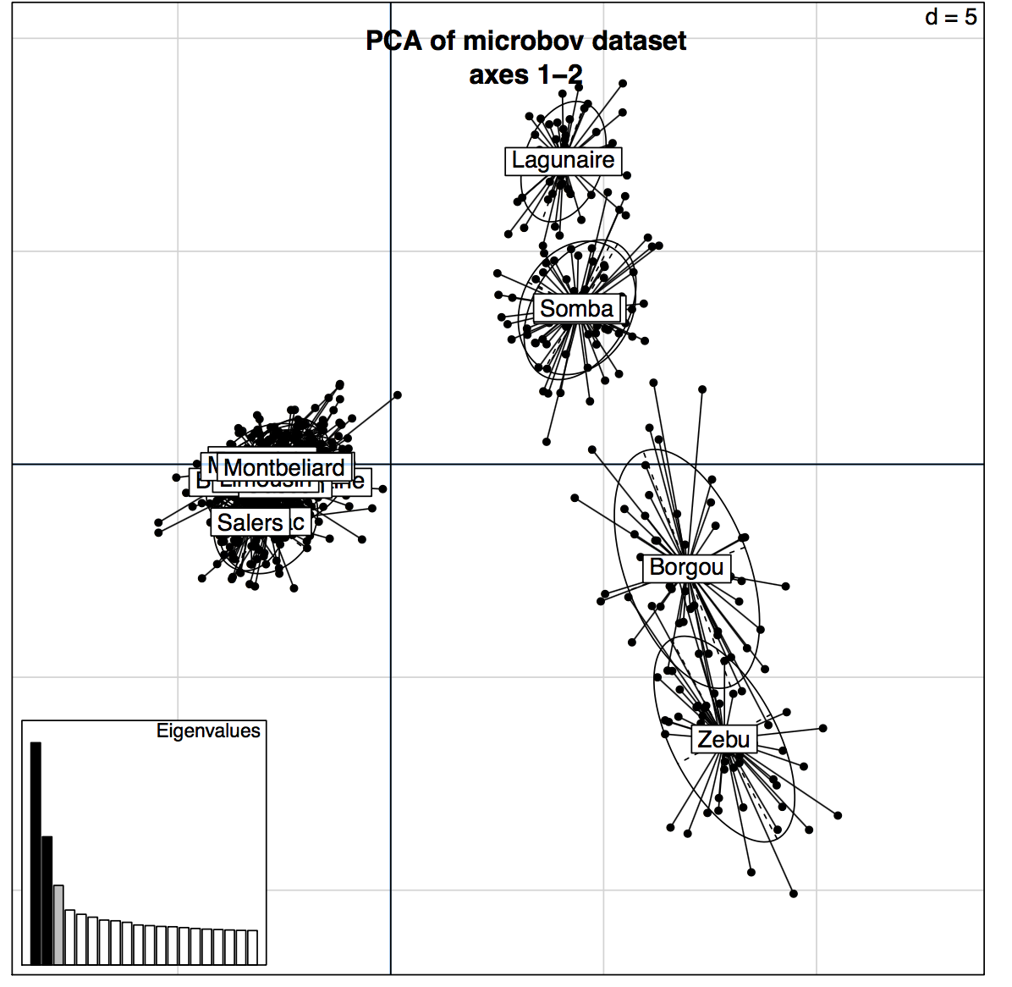
improve the graph
get rid of those awful labels:
insert elipticals (inertia)
use a single label per pop
– installation – Adegenet overview – tutorial 1– multivariate analysis – tutorial 2 – real example –

Slide 23
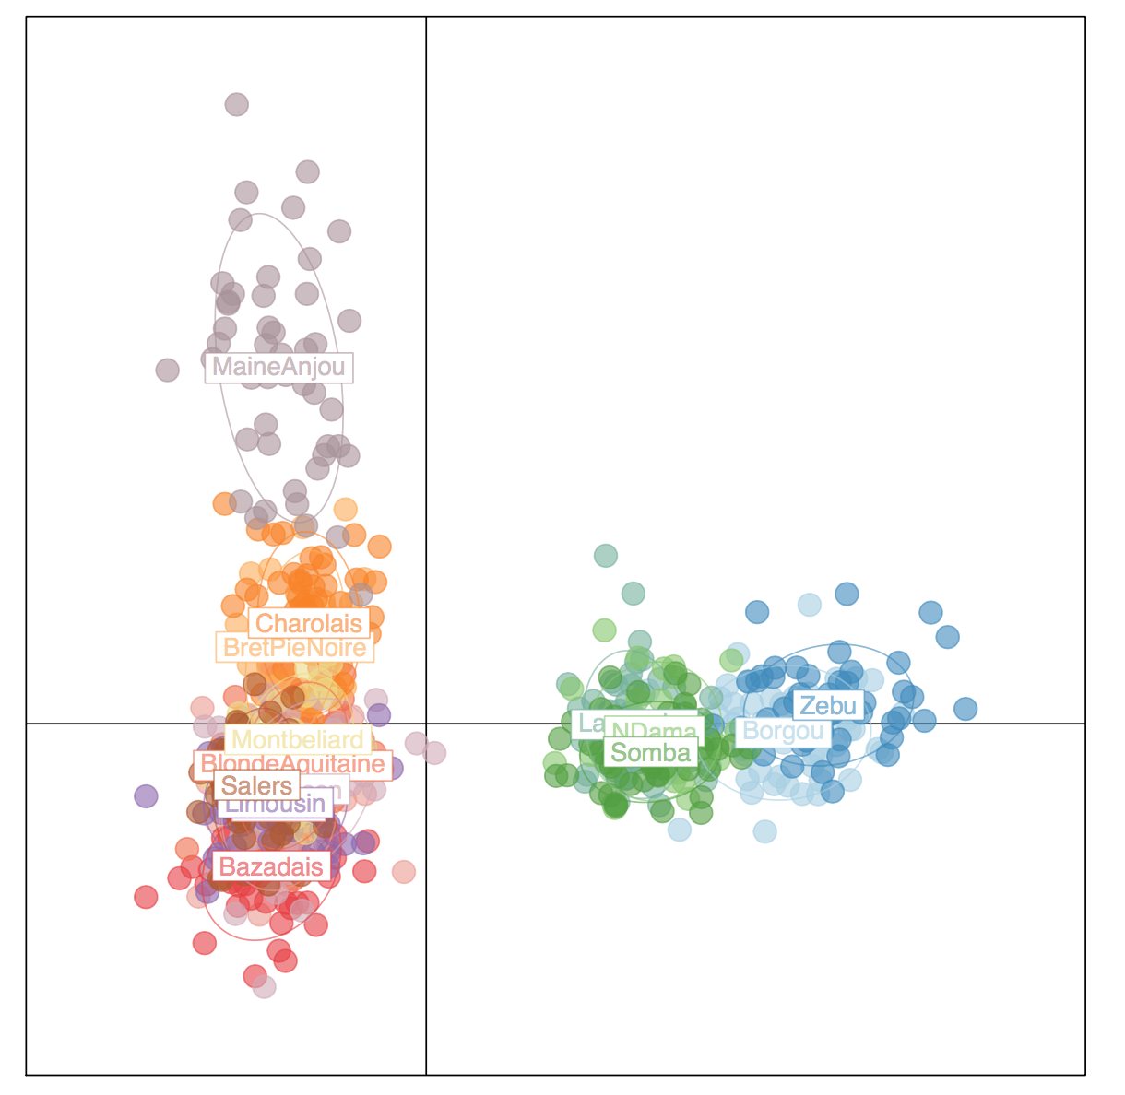
improve the graph
add color!
– installation – Adegenet overview – tutorial 1– multivariate analysis – tutorial 2 – real example –

Slide 24
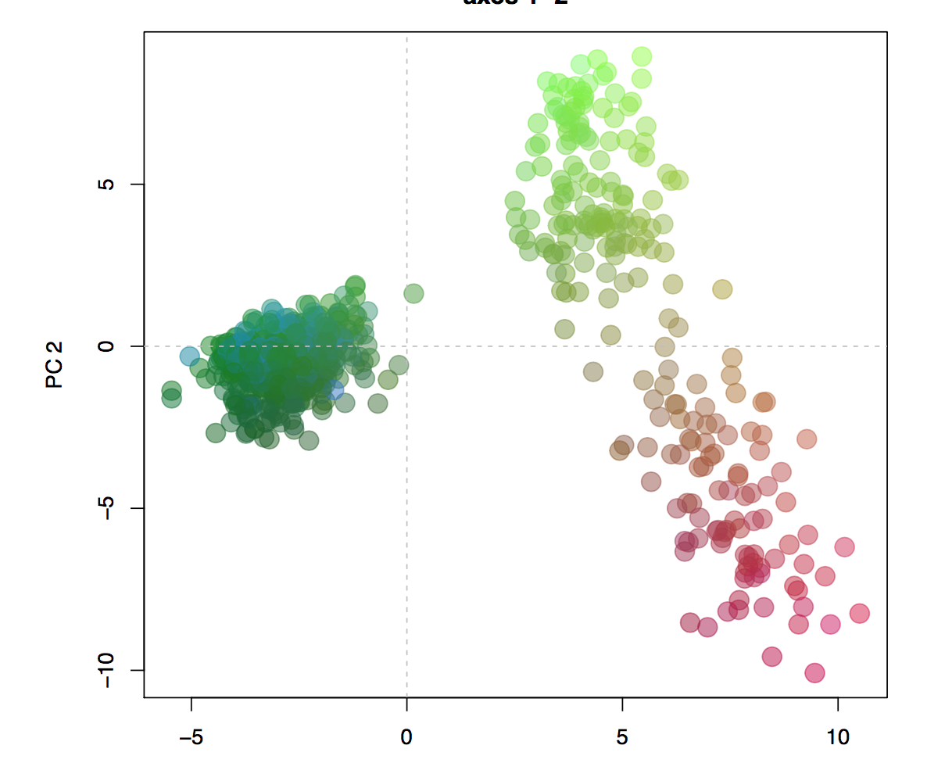
improve the graph
use color informatively
– installation – Adegenet overview – tutorial 1– multivariate analysis – tutorial 2 – real example –

Slide 25
reproducibility
always record data transformations and analytical decisions
centering
scaling
number of retained axes
chosen alleles (discriminant analysis)
use R! or another free, script-based software
– installation – Adegenet overview – tutorial 1– multivariate analysis – tutorial 2 – real example –

Slide 26
getting help
tutorials: https://github.com/thibautjombart/adegenet/wiki/Tutorials
forum
adegenet-forum@lists.r-forge.r-project.org
R/cran
help.search("Hardy-Weinberg")
?spca
email authors
– installation – Adegenet overview – tutorial 1– multivariate analysis – tutorial 2 – real example –

Slide 27
more resources
Adegenet on the web:
http://adegenet.r-forge.r-project.org/
– installation – Adegenet overview – tutorial 1– multivariate analysis – tutorial 2 – real example –

Slide 28
please cite:
Jombart T. (2008) adegenet: a R package for the multivariate analysis of genetic markers. Bioinformatics 24:1403-1405
– installation – Adegenet overview – tutorial 1– multivariate analysis – tutorial 2 – real example –

Slide 29
tutorial 2 (focused on just PCA)
perform PCA on dataset ‘microbov’ following the script “Adegenet_Tutorial.R” starting at line 53
what does color represent in the final graph?
how do you change the final plot to display PC1 and PC2 instead of PC1 and PC3?
– installation – Adegenet overview – tutorial 1– multivariate analysis – tutorial 2 – real example –

Slide 30


streamertail hummingbirds (Trochilus spp.) from Jamaica
– installation – Adegenet overview – tutorial 1– multivariate analysis – tutorial 2 – real example –

Slide 31
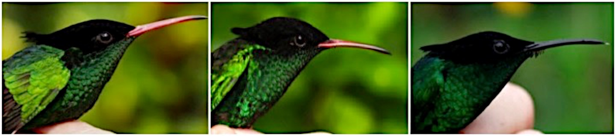
they hybridize...
T. polytmus
Hybrid
T. scitulus
– installation – Adegenet overview – tutorial 1– multivariate analysis – tutorial 2 – real example –

Slide 32
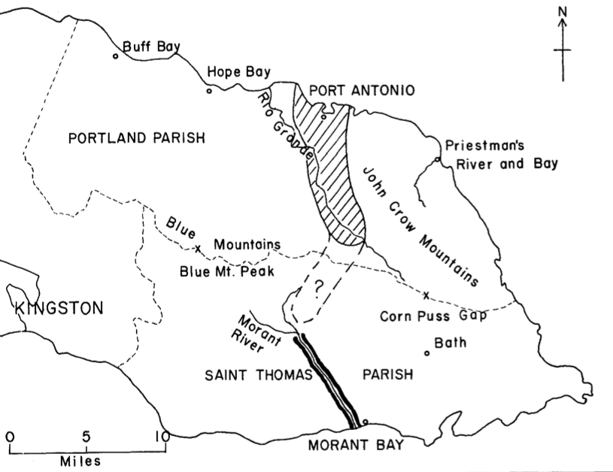
map of the hybrid zone
– installation – Adegenet overview – tutorial 1– multivariate analysis – tutorial 2 – real example –

Slide 33
no structure detected
Red-billed
hybrid
Black-billed
– installation – Adegenet overview – tutorial 1– multivariate analysis – tutorial 2 – real example –
Notes:
K=2, 105 SNPs with highest FST, admixture model

Slide 34
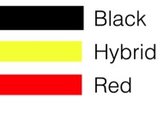
PCA using ~6,000 SNPS shows some divergence
158 individuals; 6451 SNPs
– installation – Adegenet overview – tutorial 1– multivariate analysis – tutorial 2 – real example –

Slide 35
DAPC is able to distinguish between a priori groups
true populations
randomized groups
– installation – Adegenet overview – tutorial 1– multivariate analysis – tutorial 2 – real example –

Slide 36
use the DAPC allelic loadings creatively
– installation – Adegenet overview – tutorial 1– multivariate analysis – tutorial 2 – real example –

Slide 37
103 SNPs above threshold used in structure analysis....
Red-billed
hybrid
Black-billed
– installation – Adegenet overview – tutorial 1– multivariate analysis – tutorial 2 – real example –

